Slide 1

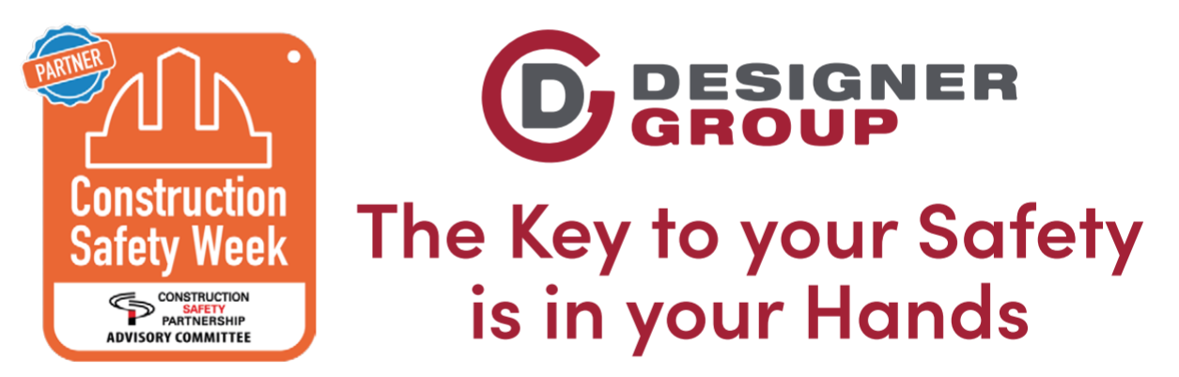
CONSTRUCTION SAFETY WEEK 2020
Thursday 22/10/2020:
Working Safely at Height

Slide 2
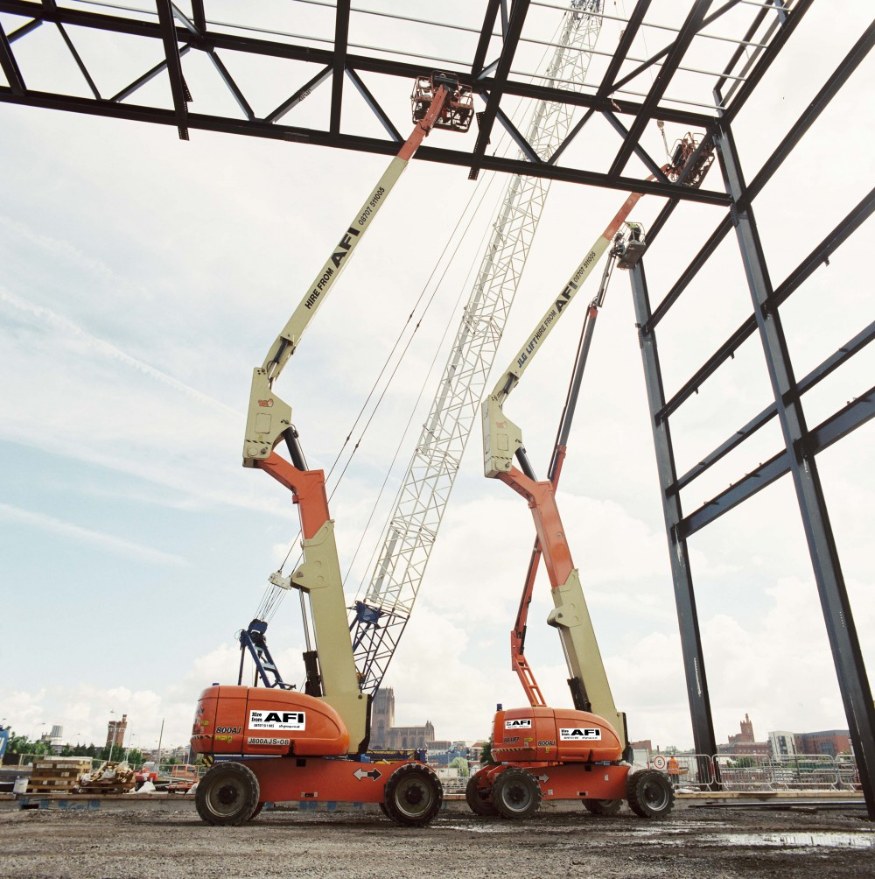
Working Safely at Height
Working at height definition as follows:
Working at height in any place, except a staircase in a permanent place, where a person could be injured by falling from it, even if it is at, or below ground
Examples of work activities that are classified as working at height:
Working on Working Platforms / Trestles
Working on a flat roof
Erecting false work or formwork
Working off ladders, scaffolding, roof work, MEWPS etc.
Working at ground level adjacent to an excavation
Working on formwork within an excavation
Working near or adjacent to fragile materials
Notes:
Discuss the consequences of this
Arc flash hotter than the sun – 20,000 degrees

Slide 3
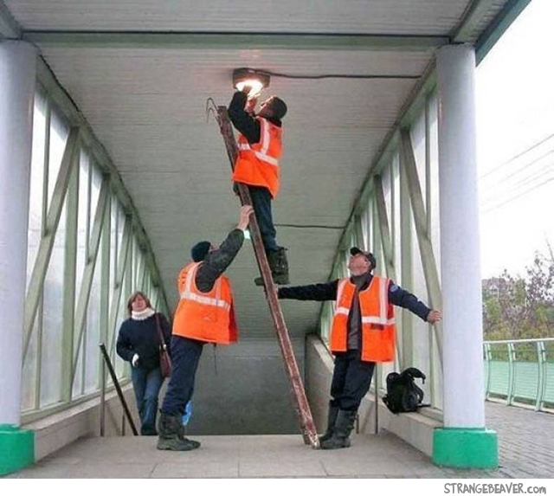
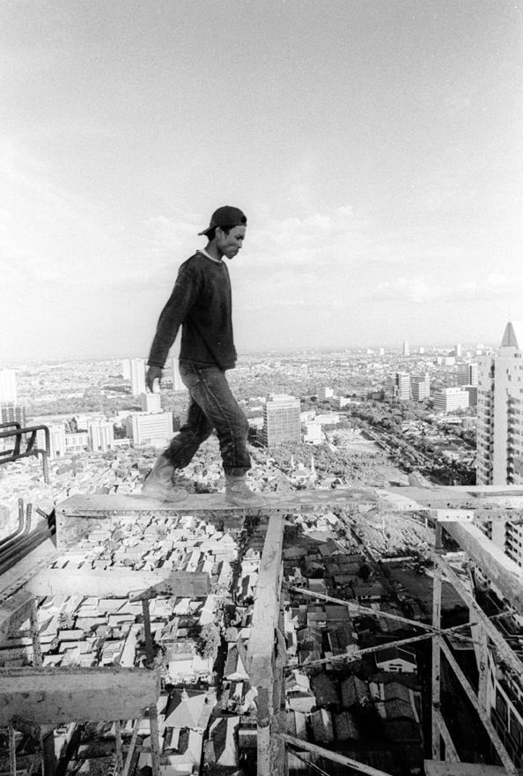
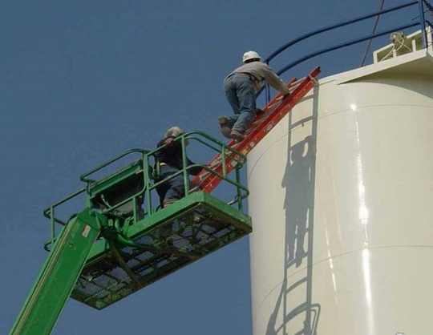
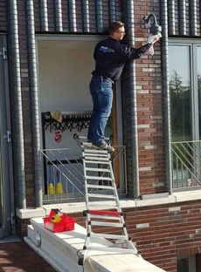
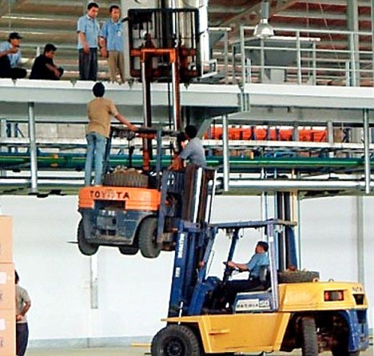
Working Safely at Height
Notes:
Discuss the consequences of this
Arc flash hotter than the sun – 20,000 degrees

Slide 4
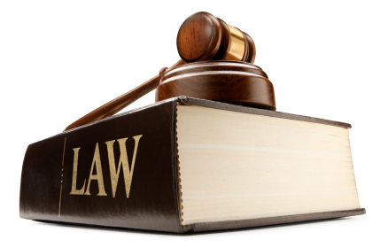
Working Safely at Height
Legislation relevant to Working at Height
The Safety, Health & Welfare at Work Act 2005
Safety, Health & Welfare at Work (Construction) Regulations 2013
Safety, Health & Welfare at Work (General Applications) Regulations 2007, Part 4 - Work at Height
Code of Practise for Working and Access Platforms 2019
Code of Practise for Safety in Roofwork 2016
Refer to HSA webpage: www.hsa.ie for further details
Notes:
Discuss the consequences of this
Arc flash hotter than the sun – 20,000 degrees

Slide 5
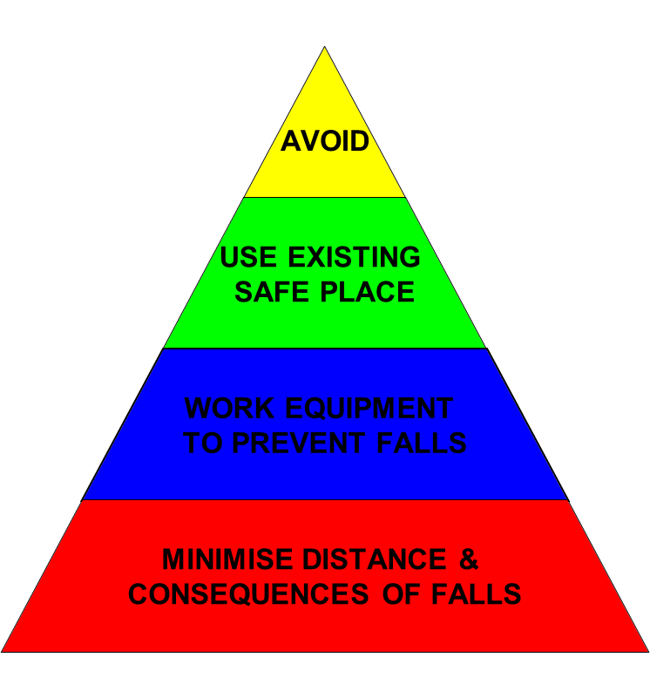
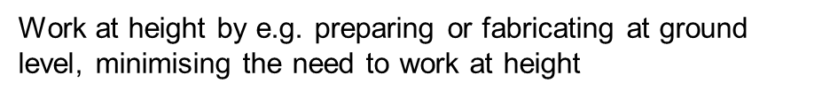
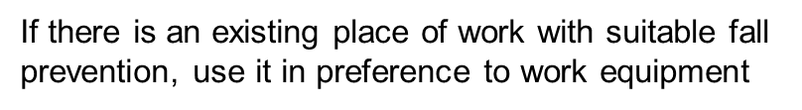
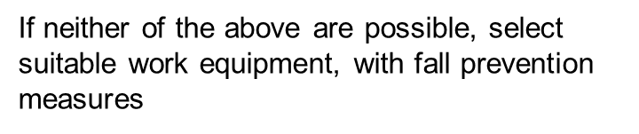
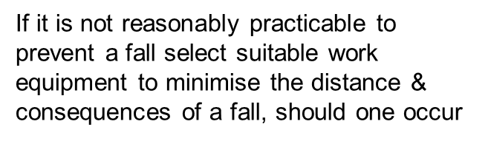
Working Safely at Height
Working at height: Hierarchy of Measures
Notes:
Discuss the consequences of this
Arc flash hotter than the sun – 20,000 degrees

Slide 6
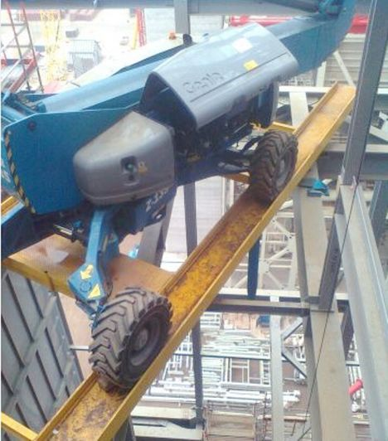
Working Safely at Height
Factors involved in Falls from a height
Failure to provide safe place of work
Failure to provide safe plant / equipment (CE/EN)
Inadequate information, instruction, training or supervision
Failure to use the proper equipment
Weather conditions
Inadequate Risk Assessments
Unsafe practises
Failure to have an emergency plan or procedure in place
Notes:
Discuss the consequences of this
Arc flash hotter than the sun – 20,000 degrees

Slide 7
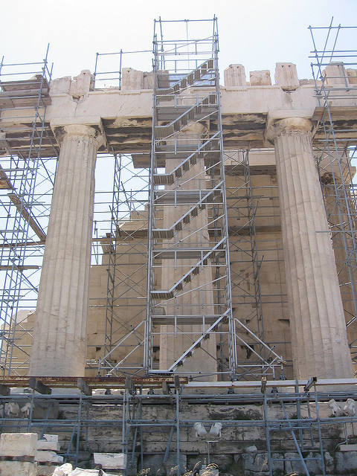
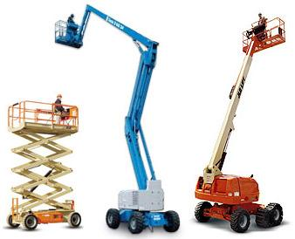
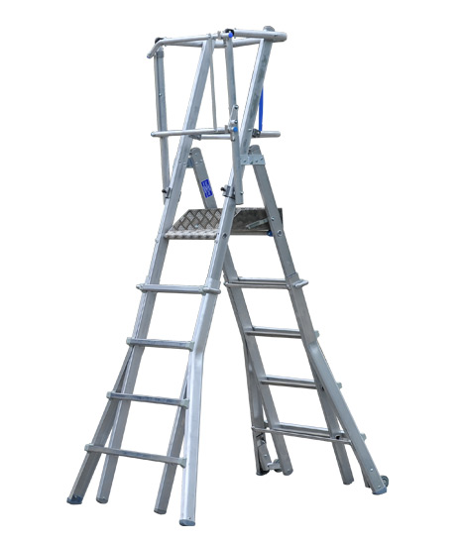
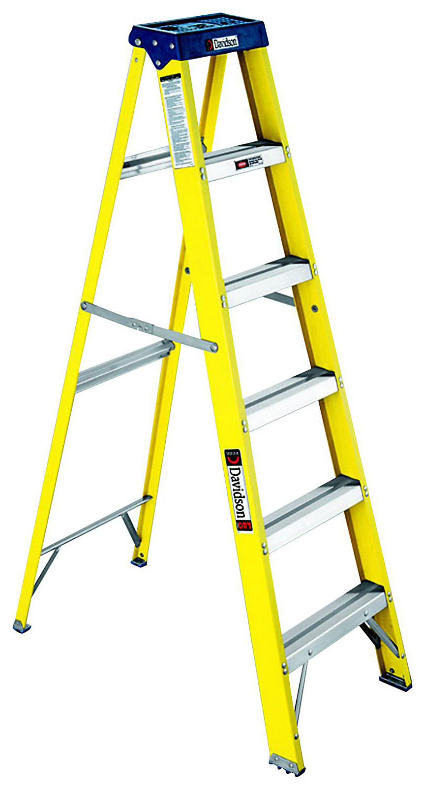
Working Safely at Height
WORKING AT height EQUIPMENT: correct assessment
Scaffold System
M.E.W.P’s
Podium Ladder
A-Frame Ladder
Notes:
Discuss the consequences of this
Arc flash hotter than the sun – 20,000 degrees

Slide 8
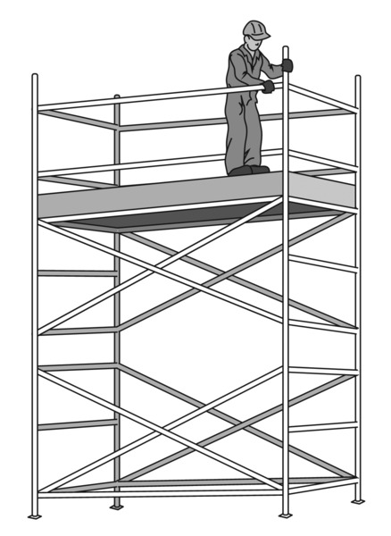
Working Safely at Height
WORKING AT height EQUIPMENT: Scaffolding / Mobile Tower
It is a criminal offence to tamper with scaffolding components. DO NOT INTERFERE with any scaffolding
Competent, Trained and Certified persons must only make alterations
Must be inspected every 7 days
Guardrails and toe boards must be fitted where a person is liable to fall
Don’t throw, drop or tip material from heights – either lower or dispose of them through a chute
Carry out a visual inspection at the start of each shift prior to use
Don’t use incomplete scaffolding. CHECK THE TAG!!s
Notes:
Discuss the consequences of this
Arc flash hotter than the sun – 20,000 degrees

Slide 9
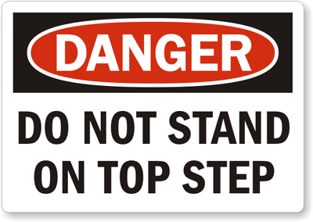
Working Safely at Height
WORKING AT height EQUIPMENT: podium / a-frame ladders
Ladders should only be used as work equipment where a risk assessment shows the use of other work equipment is not justified. The work at height regulations do not ban ladders, but do require careful consideration to be given to their use. As a guide only use a ladder
Where the work is of short duration – less that 30 minutes
For light works
Where you can maintain three points of contact on the ladder
You must ensure that:
The ladder is inspected before each use, ladder tag to be signed off at least within the last 7 days
All rungs, steps and free of Oil & Debris
All fittings are tight
Non-skid pads are in place
No structural defects, locking clips in good order
Notes:
Discuss the consequences of this
Arc flash hotter than the sun – 20,000 degrees

Slide 10
Working Safely at Height
WORKING AT height EQUIPMENT: MOBILE ELEVATED WORK PLATFORMS mewp’s
MEWP’s are known as Mobile Elevated Working Platforms which include:
Scissor Lifts
Stick Boom Lifts (Cherry Picker)
Push Around Vertical (PAV)
Articulating Boom Lift
Truck Mounts
All operatives must be trained and certified
Daily checks to be complete before use i.e. GA 2 / GA 3
Ensure basket pins are all fully secure
Use the steps and hand holds to mount the machine
Passengers must be aware of the hazards and alert the operator of such hazards
Exclusion zones / spotters in place
Notes:
Discuss the consequences of this
Arc flash hotter than the sun – 20,000 degrees

Slide 11
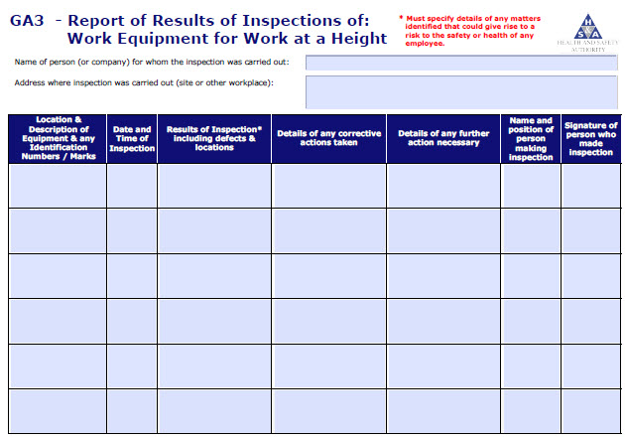
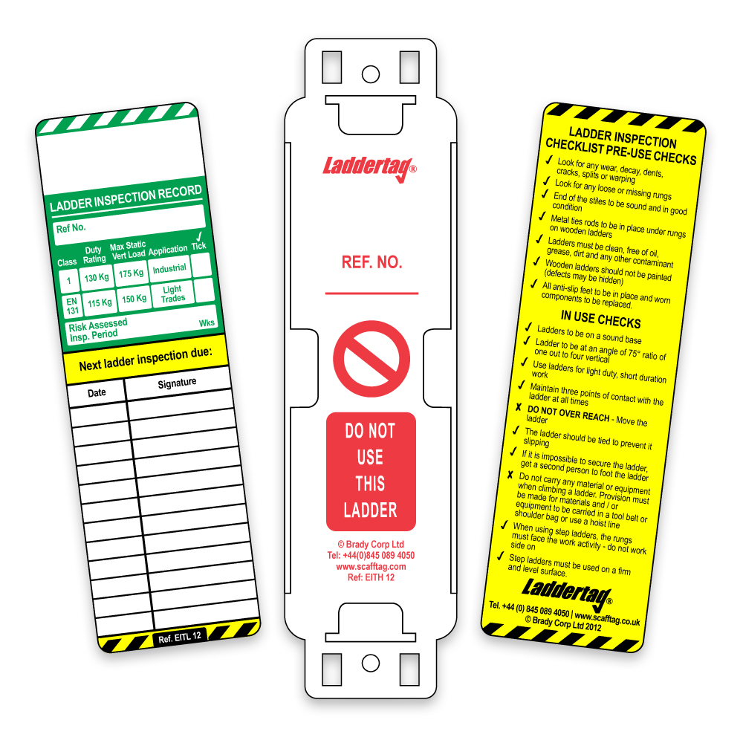
Working Safely at Height
WORKING AT height: LADDER INSPECTION TAGS & CHECKLIST
LADDERS SHOULD BE CHECKED IN ACCORDANCE WITH THE REGULATIONS
A weekly (GA3) should be filled out thereafter
Notes:
Discuss the consequences of this
Arc flash hotter than the sun – 20,000 degrees

Slide 12
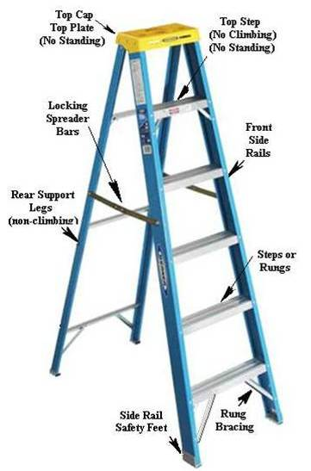
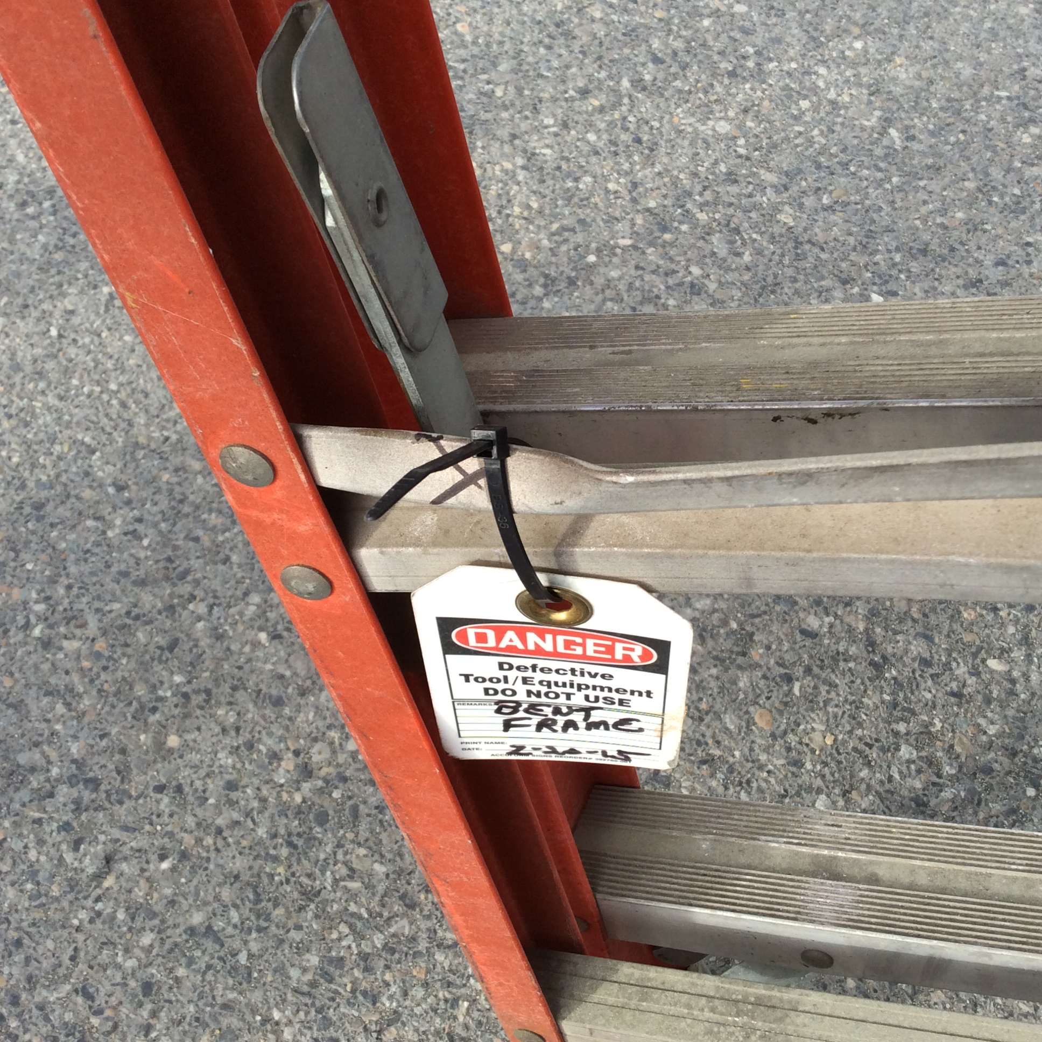
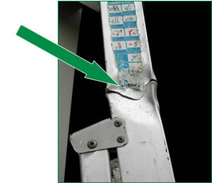
Working Safely at Height
WORKING AT height: Pre-Use Inspection of Ladder
(EXAMPLE)
Always inspect a ladder before and after use:
Side rails aren’t bent, broken, twisted or split
Rungs, cleats or steps aren’t bent, broken or missing
All bolts and rivets are in place and securely tightened
Joints between the side rails and the individual rungs are tight
Notes:
Discuss the consequences of this
Arc flash hotter than the sun – 20,000 degrees

Slide 13
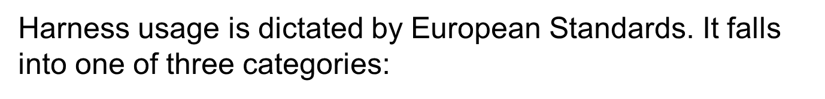
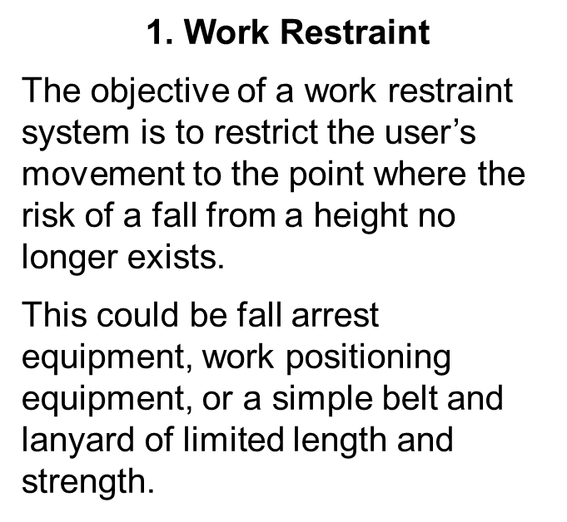
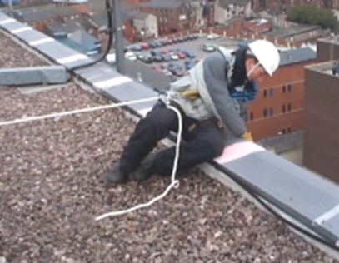
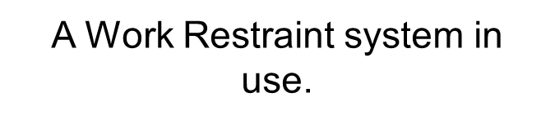
Working Safely at Height
WORKING AT height equipment: harness
Notes:
Discuss the consequences of this
Arc flash hotter than the sun – 20,000 degrees

Slide 14
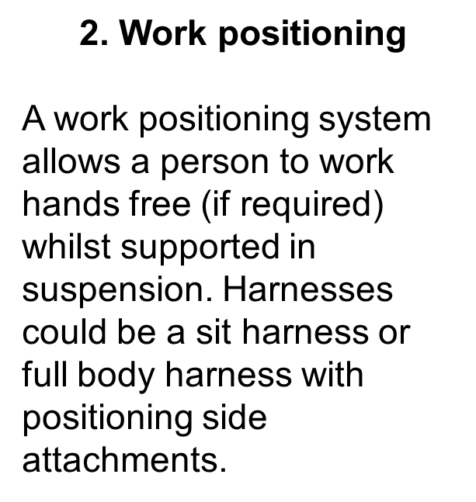
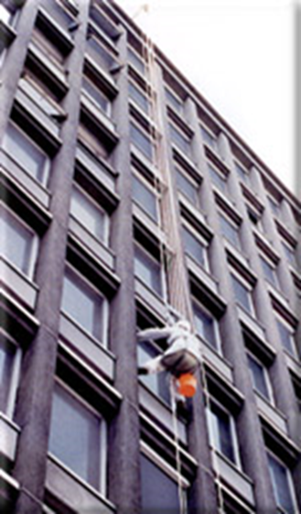

Working Safely at Height
WORKING AT height equipment: work positioning
Notes:
Discuss the consequences of this
Arc flash hotter than the sun – 20,000 degrees

Slide 15
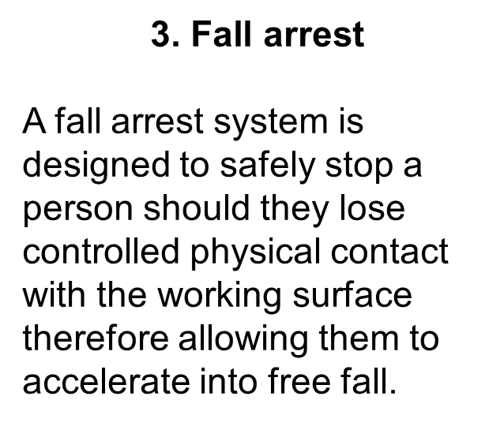
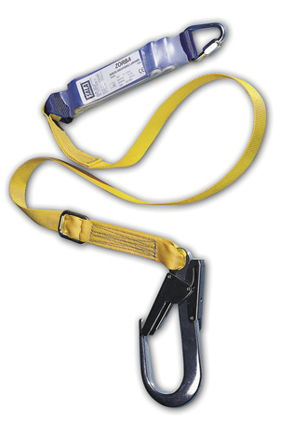
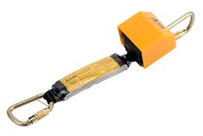
Working Safely at Height
WORKING AT height equipment: fall arrest systems
FALL ARREST EQUIPMENT
Notes:
Discuss the consequences of this
Arc flash hotter than the sun – 20,000 degrees

Slide 16
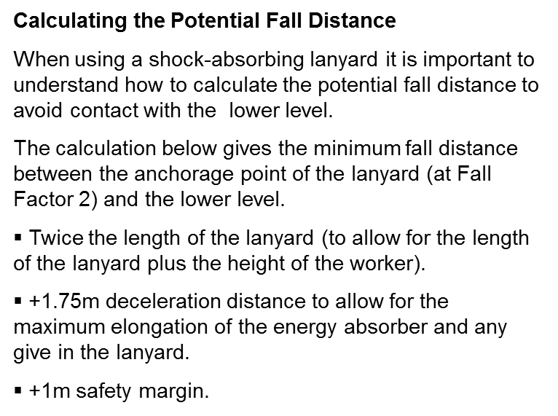
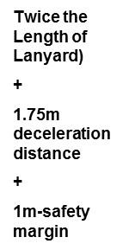
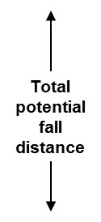
Working Safely at Height
WORKING AT height: falling… the facts
Notes:
Discuss the consequences of this
Arc flash hotter than the sun – 20,000 degrees

Slide 17
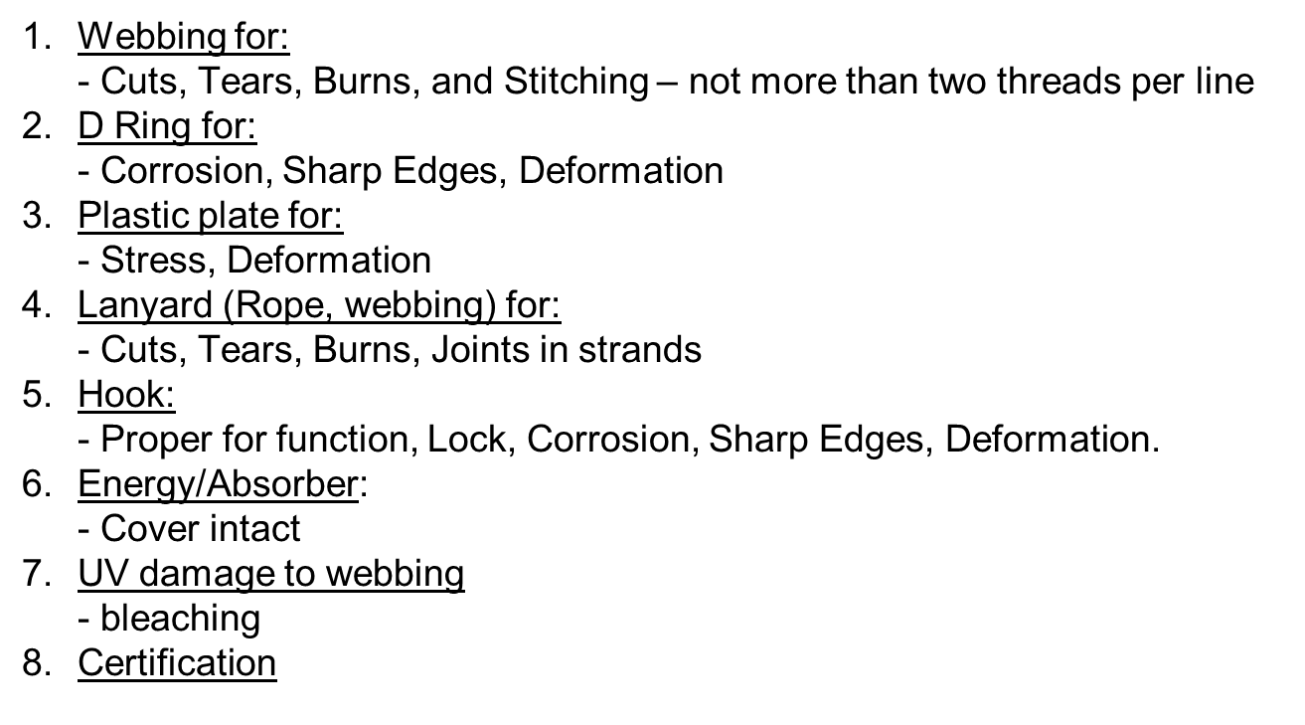
Working Safely at Height
WORKING AT height equipment: fpe User inspection
Notes:
Discuss the consequences of this
Arc flash hotter than the sun – 20,000 degrees

Slide 18
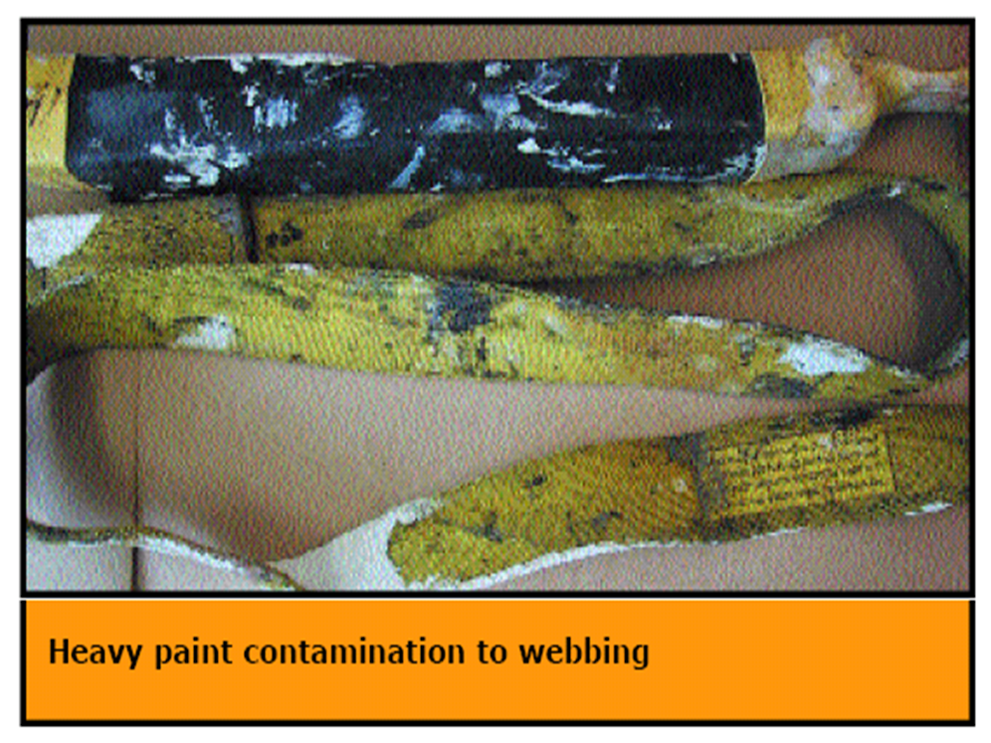
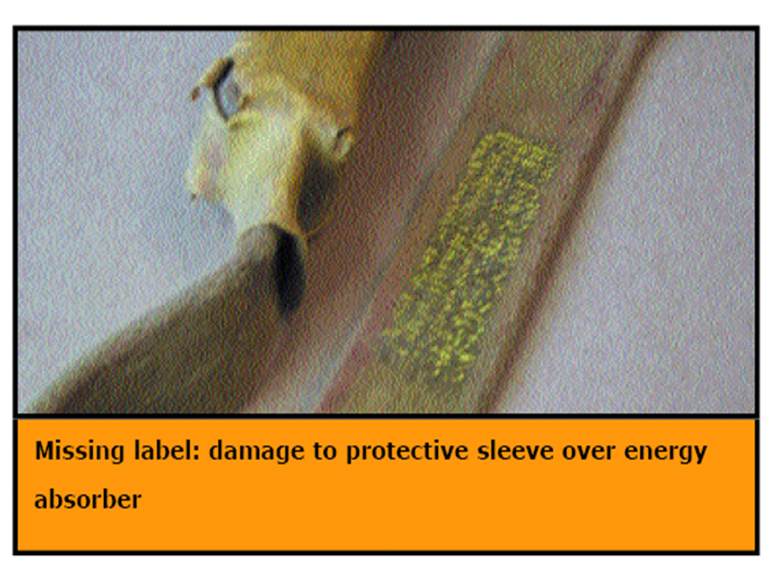
Working Safely at Height
WORKING AT height equipment: fpe damaged equipment
Notes:
Discuss the consequences of this
Arc flash hotter than the sun – 20,000 degrees

Slide 19


+353 (01) 860 0520 | designergrp.com |Clyde House, IDA Blanchardstown Business & Technology Park, Snugborough Road, Dublin 15
​

