Slide 1
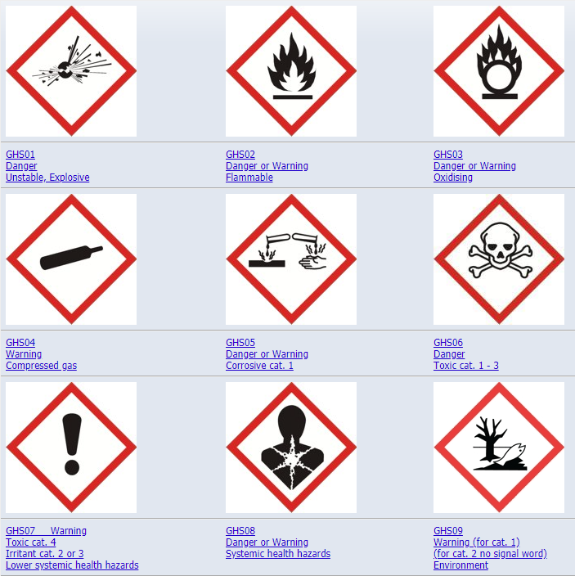
HAZARDOUS CHEMICALS – TOOLBOX TALK
What is a hazardous chemical?
‘A hazardous chemical is a substance that has properties with the potential to do harm to human or animal health, the environment or is capable of damaging property.’
How can chemicals cause harm to health?
Chemicals can come into contact or enter the body through the following;
Inhalation – breathing in contaminated air.
Skin Contact
Ingestion – hand to mouth contact.
Injection – through sharp objects such as needles.
Identifying chemical hazards:
All chemicals but come to site with the relevant safety information e.g. safety data sheet (SDS). Safety information must all be visible on the chemical container.
The GHS hazard pictograms allows us to easily identify the hazards associated with a particular chemical substance.
Notes:
Discuss the consequences of this
Arc flash hotter than the sun – 20,000 degrees

Slide 2
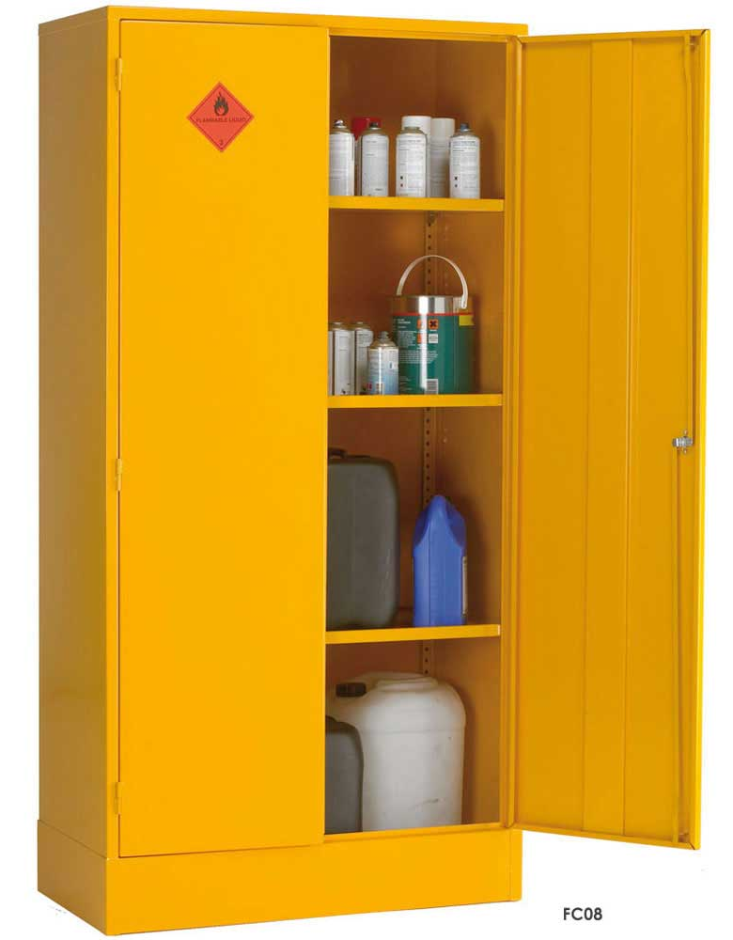
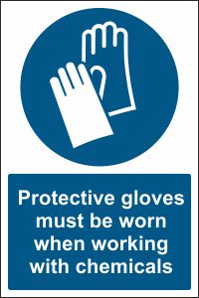
HAZARDOUS CHEMICALS – TOOLBOX TALK
Assessing Chemical Exposure:
The use of chemical substances must be adequately risk assessed prior to use on site.
When assessing chemical exposure you must take the following into consideration;
How many people are exposed to the chemical? Can non-users be exposed?
How is the chemical used (sprayed/poured) and for how long?
Quantity used?
How will the user be exposed e.g. skin contact, inhalation?
Controlling Chemical Risks:
Use of engineering controls such as local exhaust ventilation (LEV)
Additional PPE (e.g. chemical gloves, goggles, respiratory masks).
Training for employees.
Appropriate storage arrangements.
Emergency procedures.
Notes:
Discuss the consequences of this
Arc flash hotter than the sun – 20,000 degrees

Slide 3
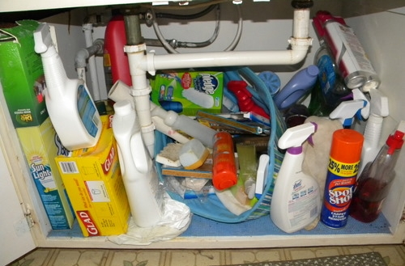
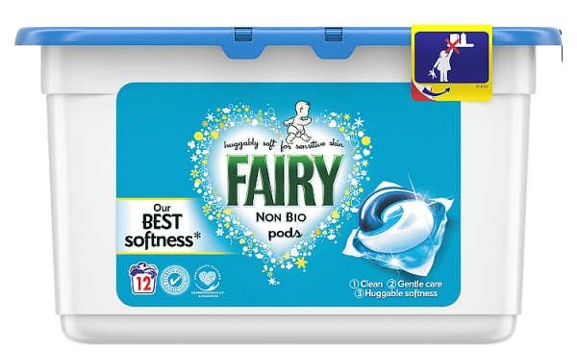
HAZARDOUS CHEMICALS – TOOLBOX TALK
Chemicals in the Home:
It is not only important to be aware of the hazards posed by chemicals in the workplace but also in the home!
Hazardous chemicals should be stored under conditions which consider the chemical’s specific properties.
In most households in Ireland; chemical agents and cleaning products are commonly stored under the kitchen sink or under the stairs. This poses a high risk due to several reasons.
For example; certain chemicals can react together to form unstable or toxic products or can produce heat. Flammable liquids near a heat source can result in a fire so it is important that flammable substances should be segregated.
As well as this, unless kept under lock and key, these products are easily accessible for children. A common example of this is liquid washing pods poisoning young children as a result of ingestion.
Notes:
Discuss the consequences of this
Arc flash hotter than the sun – 20,000 degrees

