Slide 1


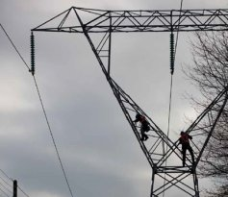
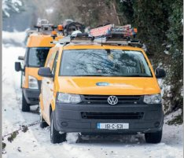
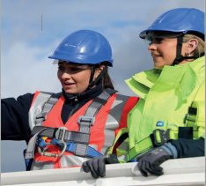
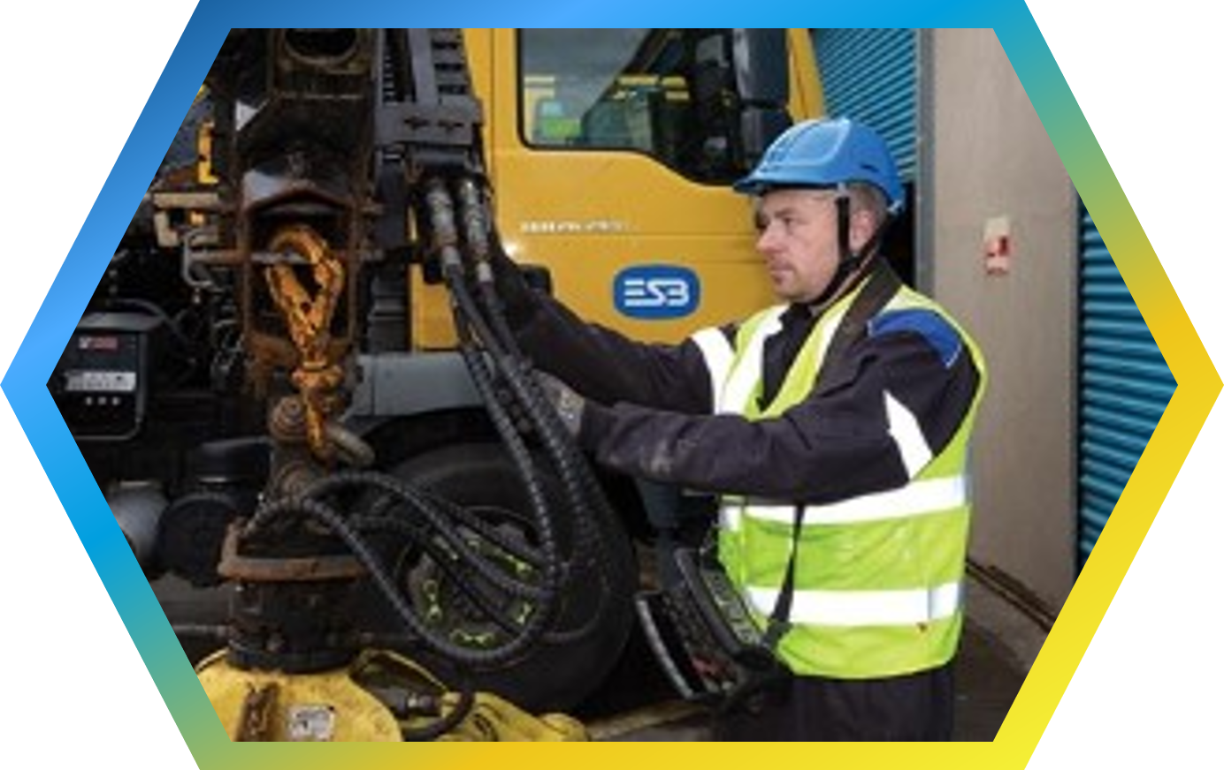

Avoiding Dangers From Electricity
CIF Construction Safety Month 2023
Because we care
This presentation is for information purposes only and is not to be circulated or disseminated without the prior consent of ESB Networks’ Public Safety Manager

Slide 2
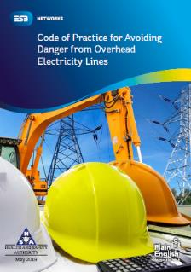
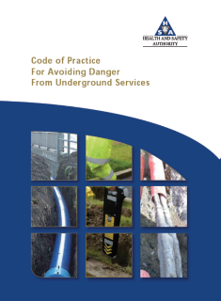
Avoiding the Dangers of Electricity – Compliance is Key
Coming in contact with overhead or underground electricity wires or cables is extremely dangerous. The power of electricity is such that any accidental contact or even coming close will result in serious injury can be fatal.
Compliance with the Health and Safety Authority Approved Codes of Practice in conjunction with your own documented safe systems of work will keep you and your fellow construction workers safe.
The Codes of Practice are comprehensive safety documents which require that you understand all requirements and that you implement all the necessary controls to ensure the risk from the overhead and underground electricity network is managed effectively.
For further safety information to help you stay safe and avoid the dangers of electricity please refer www.esbnetworks/stayingsafe

Slide 3
Roles and Responsibilities & Practical Advice
Sets out statutory requirements
Gives practical advice to plant and machinery drivers and operators to avoid coming into contact with overhead electricity lines and underground services
Safe System of Work
Remember the importance of carrying out a risk assessment / SSWP for all work. Consider the hazard of electricity
Always refer to Your Company documentation
If an electricity cable, telecommunications cable, gas pipeline or water main suffers any impact or any damage, however slight, the incident must be reported to the network operator without any undue delay.

Slide 4
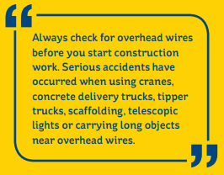
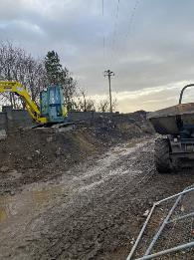
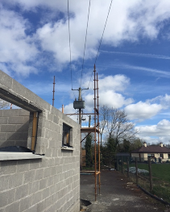
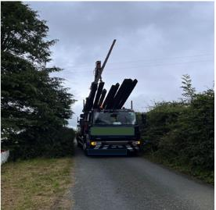
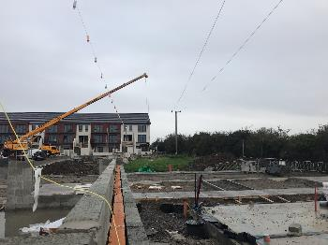
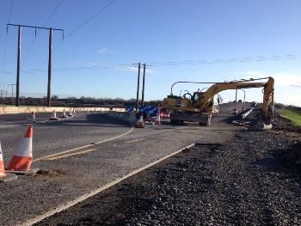
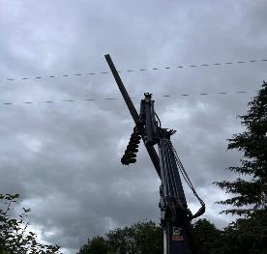
Poor Construction Practices Put You At Risk

Slide 5
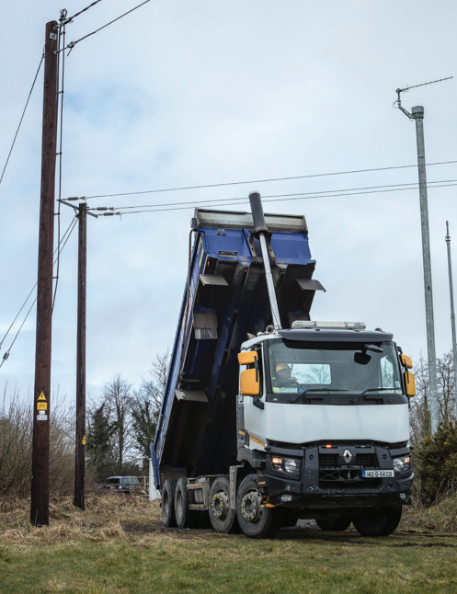
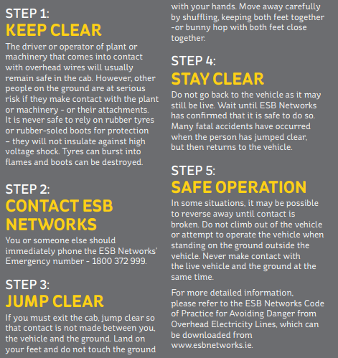
Remember these 5 Steps to Staying safe

Slide 6
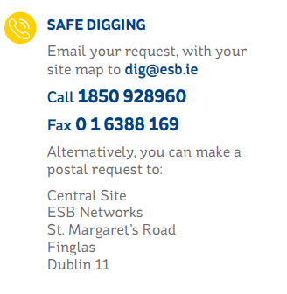

Do You Know What lies Below?
Always Dial Before you Dig
You should always check the area for signs that might suggest the presence of service cables and use a cable locator and safe digging practice
Always assume that there are more buried cables present than you have located.
Remember that service cables and public lighting cables may not be shown on the map.
Always be aware that the depth of cover may be very shallow and that there may be no bricks, warning tape or other protection in place. Some cables may be found at very shallow depths.
Look out for any indication of other services such as gas, water, etc.
Mark cable position on the ground. You should make the position of all cables located on the ground using waterproof paint or crayon.
If an electricity cable, telecommunications cable, gas pipeline or water main suffers any impact or any damage, however slight, the incident must be reported to the network operator without any undue delay.
1800 928 960

Slide 7
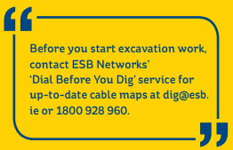
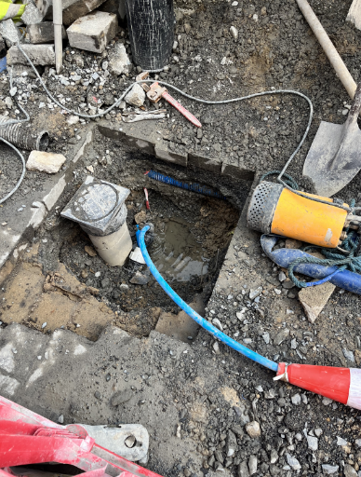
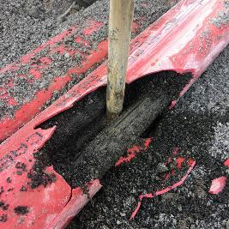
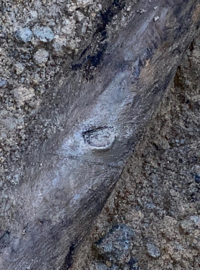
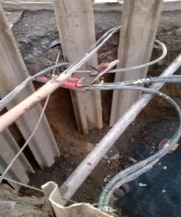
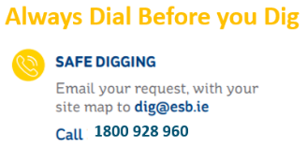
Poor Construction Practices Put You At Risk

Slide 8
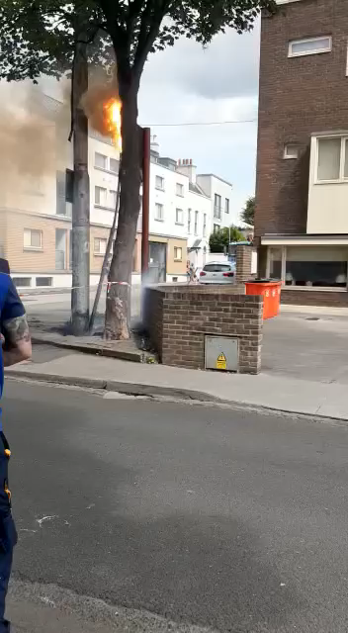
Are You Feeling Lucky?

Slide 9

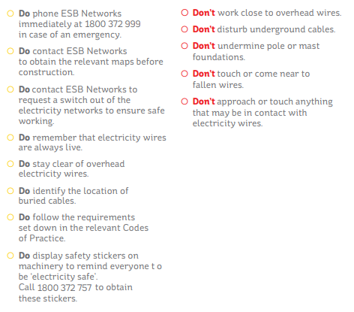
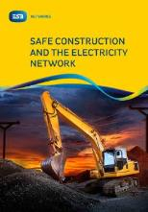

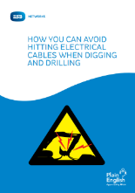
Key Safety Takeaways from Today
Your Roles & Responsibilities
Sets out statutory requirements
Always Implement Safe System of Work
Remember the importance of carrying out a risk assessment / SSWP for all work. Consider the hazard of electricity
Always refer to Your Company documentation
https://www.esbnetworks.ie/staying-safe/staying-safe

Slide 10
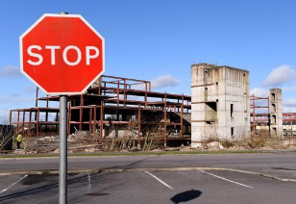
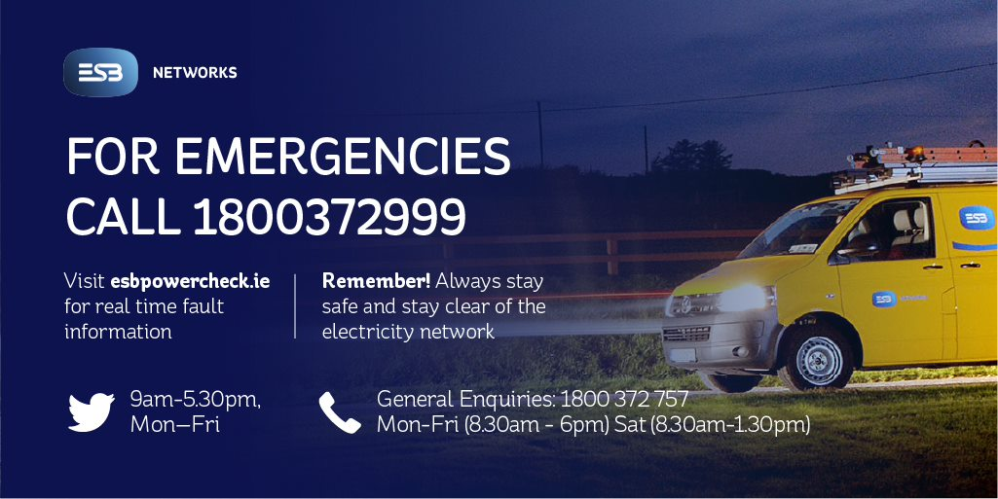
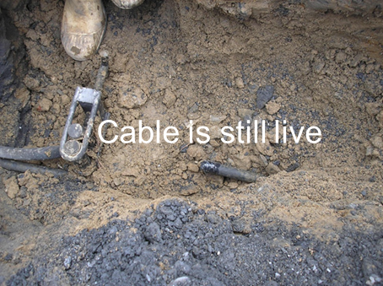
If The Worst Happens….
Stay Safe,
Stay Clear

Slide 11


