Slide 1


1

Slide 2
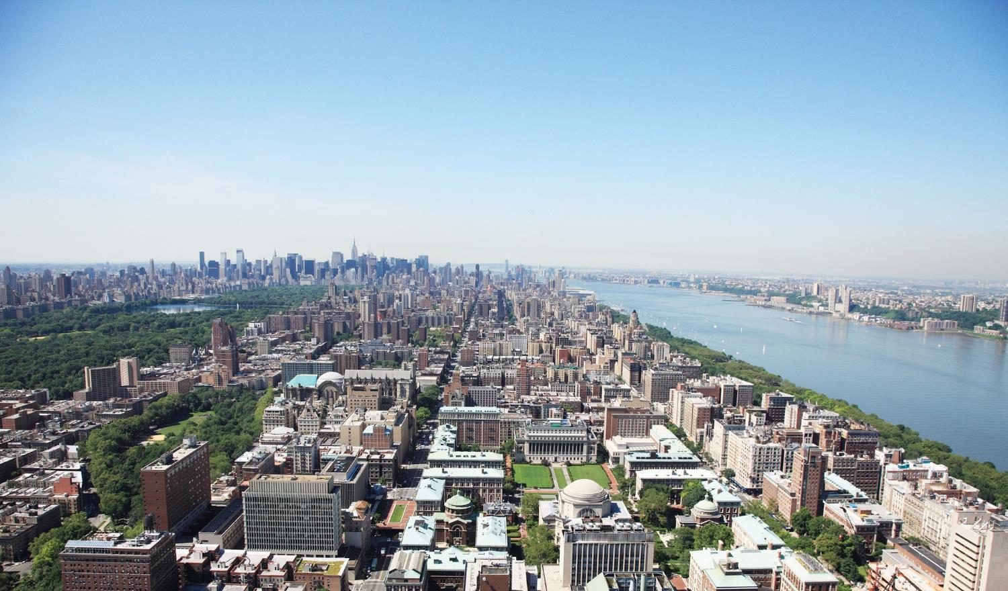
Shaping the Future of Construction
By Professor Ibrahim Odeh
odeh@Columbia.edu

Slide 3
Agenda
Construction Industry Environment
Trends Shaping the Industry
Industry Transformation Framework
Examples
3

Slide 4
Agenda
Construction Industry Environment
Trends Shaping the Industry
Industry Transformation Framework
Examples
4

Slide 5
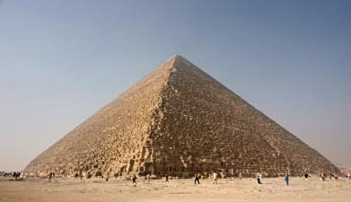
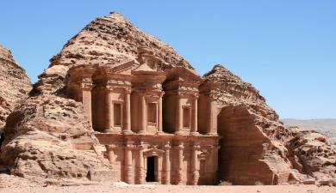
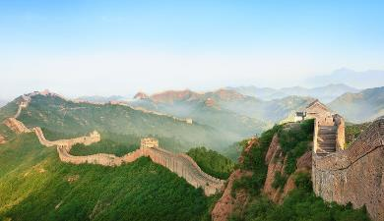
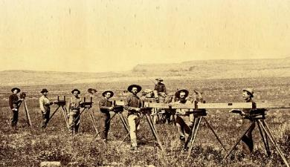

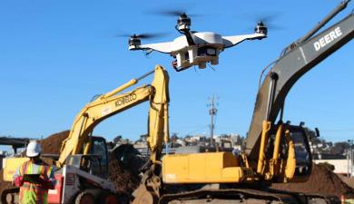
Not a new industry…
Continues evolving…
4500 years ago
2600 years ago
2200 years ago
5
Notes:
Yet only a handful of surveyor names remain familiar: George Washington, Thomas Jefferson, Abraham Lincoln. But many more risked their lives in the line of duty to map what ultimately became the passes, railroads, towns, dams and other structures that helped form the backbone of the USA.

Slide 6
Index of US Labor Productivity
Source: Global Vantage; Compustat; Bloomberg; www.aecbytes.com/ viewpoint/2013/issue_67.html; www.nber.org/papers/w1555.pdf; S&P Capital IQ; BCG ValueScience Center; World Economic Forum
6
Notes:
Peer set based on US companies with Engineering, Construction and 1964; output per working hours. Services-related Standard Industrial Classification codes. Financials are
CAGR = compound average growth rate

Slide 7
Construction Industry Environment
7

Slide 8
The Industry Internal Challenges
Insufficient knowledge transfer from project to project
  Lessons learned from one project could be usefully to another. Few companies institutionalized such a process. Projects rely heavily on PM expertise.
Planning Process
Develop
Implement
Make
Corrections
Detect
Deviation
Determine
Impact
8
Notes:
Companies often seem to put greater emphasis on defining the final product than on planning the actual construction process

Slide 9
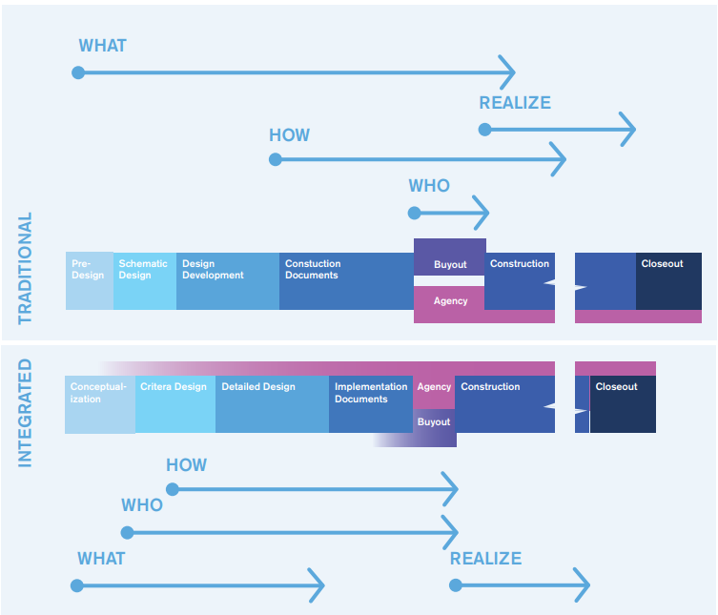
The Industry Internal Challenges
Little Cross-Functional Cooperation
  Conventional construction process is sequential.
  Input of owner, designers, constructors, and suppliers at different stages of the project. Ideally all stakeholders along the value chain should be fully exploited early on in the design and planning process.
IPD workflow demonstrating earlier involvement of stakeholders and shorter stages (AIA California Council 2007)
9
Notes:
IPD vs DBB (https://uscad.com/blog/integrated-project-delivery/)
AIA: American Institute of Architects
Weak Project Monitoring
Manufacturing industries track data. If something goes wrong it can quickly identify the root causes and implement remedies.
Shortage of Young Talent and People Development
Inadequate gender diversity and little job security (cyclical nature). Companies struggle to attract talented recruits.
Lack of Innovation and Delayed Adoption
The lifeblood of any industry is the R&D. Benefits are long term. Costs arise in present. R&D has received less attention than in other industries

Slide 10
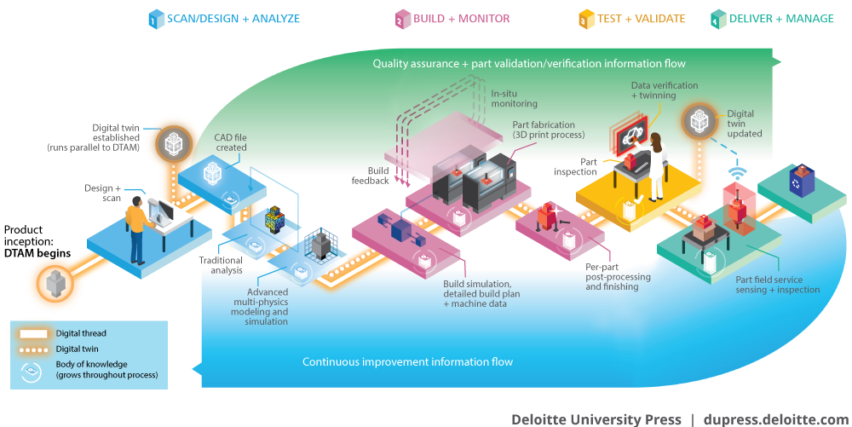
The Industry Internal Challenges
Weak Project Monitoring
  Manufacturing industries track data. If something goes wrong it can quickly identify the root causes and implement remedies.
10
Notes:
Deloitte: (https://www2.deloitte.com/insights/us/en/focus/3d-opportunity/3d-printing-blockchain-in-manufacturing.html)
Shortage of Young Talent and People Development
Inadequate gender diversity and little job security (cyclical nature). Companies struggle to attract talented recruits.
Lack of Innovation and Delayed Adoption
The lifeblood of any industry is the R&D. Benefits are long term. Costs arise in present. R&D has received less attention than in other industries

Slide 11
Agenda
Construction Industry Environment
Trends Shaping the Industry
Industry Transformation Framework
Examples
11

Slide 12


Mega Trends Shaping the Construction Industry’s Future
The construction industry is affected by megatrends in four domains:
  Market & Customers
  Sustainability & Resilience
  Society & Workforce
  Politics & Regulation
12

Slide 13
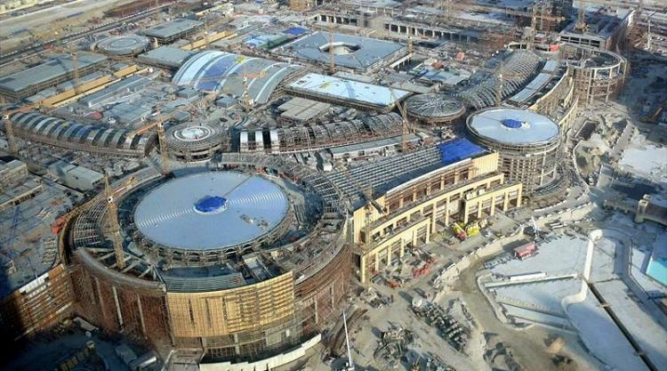
1. Market and Customers
Bigger and More Complex Projects
  Crossrail is new railway in UK running from Reading and Heathrow in the west, through 42km of new tunnels under London to Shenfield and Abbey Wood in the east.
The Dubai Mall
(US$1.3 billion)
12 Million Square Meter Total Area!
13
Notes:
The Dubai Mall is the largest retail development in the world. It offers an astounding number of stores and scope of amenities. The overall construction cost of $1.3 billion comprises over 12 million square feet total area, with leasable retail space in excess of nine million square feet.

Slide 14
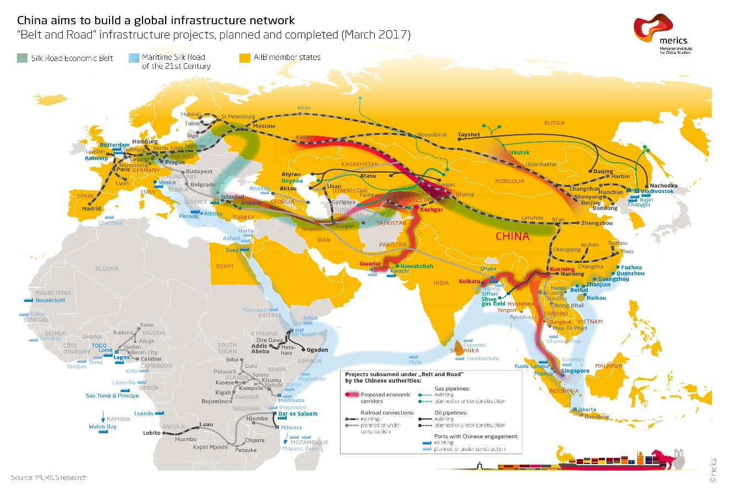
14
Notes:
https://www.merics.org/index.php/en/china-mapping/silk-road-initiative
“If you want to get rich, build a road”
Good article: http://www.theworldin.com/article/14433/edition2018digital-silk-road

Slide 15
1. Market and Customers
Ageing Infrastructure
  1 in 3 German railway bridges are more than 100 years old
  6 Billion gallons of treated water is lost due to leaking pipes in USA
I-35W Bridge - USA
credit: MANDEL NGAN/AFP/Getty Images
15
Notes:
On 15 January 2018, a partially constructed bridge in Chirajara, Colombia collapsed, killing at least 10 workers and injuring several more. The 446-metre (1,463 ft) bridge, located in the Cundinamarca Department, was part of an expansion of National Route 40 between Bogota and Villavicencio scheduled to open in March 2018. It crosses a ravine at a height of 280 metres (920 ft) and is held by stay-cables from two towers, of which one collapsed

Slide 16
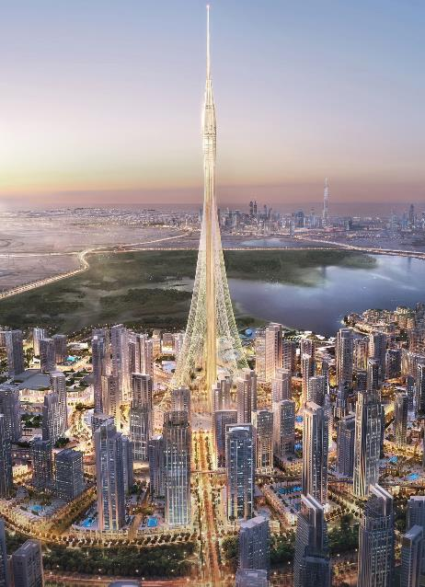
1. Market and Customers
Demand in Developing Countries
  65% of the next decade’s growth in construction will happen in emerging countries
16
Notes:
https://www.economist.com/graphic-detail/2015/04/24/constructive-one-upmanship

Slide 17
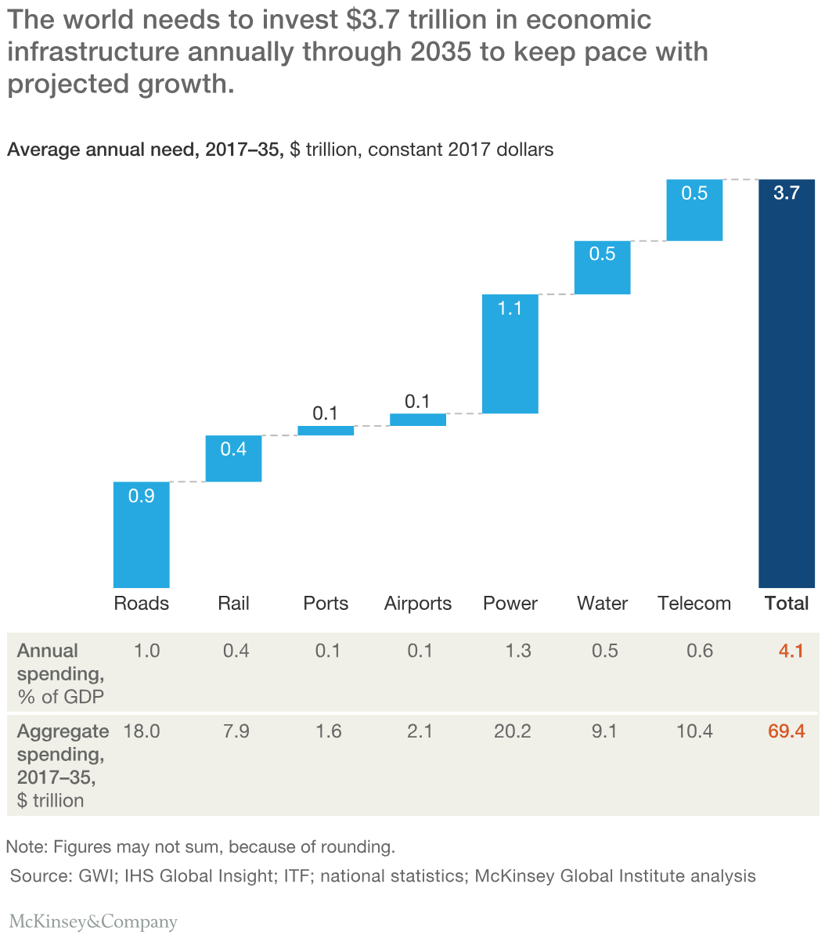
1. Market and Customers
Massive Financing Need
  $1 Trillion annual investments are needed to close the global infrastructure gap
Gap
USD 3.7 T
USD 1.0 T
USD 2.7 T
Demand
Supply
17

Slide 18
2. Sustainability and Resilience
Hurricane Maria
‘Puerto Rico’
2017
Climate Change and Resilience Challenges
  3X as many disasters were reported last year as in 1980
18
Notes:
On December 26th of 2004 … Indian Ocean earthquake occurred… The undersea megathrust earthquake triggered a series of devastating tsunamis… Killing more than 220,000 people in 14 countries… It was one of the deadliest natural disasters in recorded history… Indonesia was the hardest-hit country, followed by Sri Lanka, India, and Thailand…
In January 2010… a 7.0 magnitude earthquake hit Haiti… The earthquake killed more than 220,000 people. Its epicentre was at approximately 25 km from Port-au-Prince, the capital.
CNN: (https://www.cnn.com/2017/09/28/us/puerto-rico-maria-by-the-numbers-trnd/index.html)

Slide 19
2. Sustainability and Resilience
Sustainability Requirements
  50% of the solid waste in the US is produced by the construction industry
  #1 consumer of global raw materials is the construction industry
  30% of global greenhouse gas emissions are attributable to Buildings
Institute For Sustainable Infrastructure: Envision
US Green Building Council: LEED
Source: ustainableinfrastructure.org
19
Notes:
Leadership in Energy and Environmental Design (LEED); started 1994. is a set of rating systems for the design, construction, operation, and maintenance of green buildings which was Developed by the U.S. Green Building Council.
Envision started 2012
Other certificates system that confirms the sustainability of buildings is the British BREEAM (Building Research Establishment Environmental Assessment Method) for buildings and large-scale developments.
Published in 1990. The world's longest established method of assessing, rating, and certifying the sustainability of buildings. More than 250,000 buildings have been BREEAM-certified and over a million are registered for certification – in more than 50 countries worldwide.
The Edge: The Edge is also the ­greenest building in the world, according to British rating agency BREEAM, which gave it the highest ­sustainability score ever awarded: 98.4 percent.
The Edge: (https://www.bloomberg.com/features/2015-the-edge-the-worlds-greenest-building/)

Slide 20
3. Society and Workforce
Housing
Urbanization and Housing Crisis
  200K people are added daily to urban areas and need affordable and healthy housing
Transport
Congestion
Employment
Health
Urbanization
Sanitation
Environment
Education
Crime
20
Notes:
The urbanization here in Colombia increased from 31% of the total population in 1938, to 57% in 1951 and about 70% by 1990. Currently the figure is about 77%.

Slide 21
3. Society and Workforce
Talent and Ageing Workforce
  50% of general contractors are concerned about finding experienced crafts workers for their workforce
Source: US Bureau of Labor Statistics; World Economic Forum;
The Boston Consulting Group
21
Notes:
10,000 baby boomers in the US are retiring daily and productivity in the construction industry is declining along with it.

Slide 22
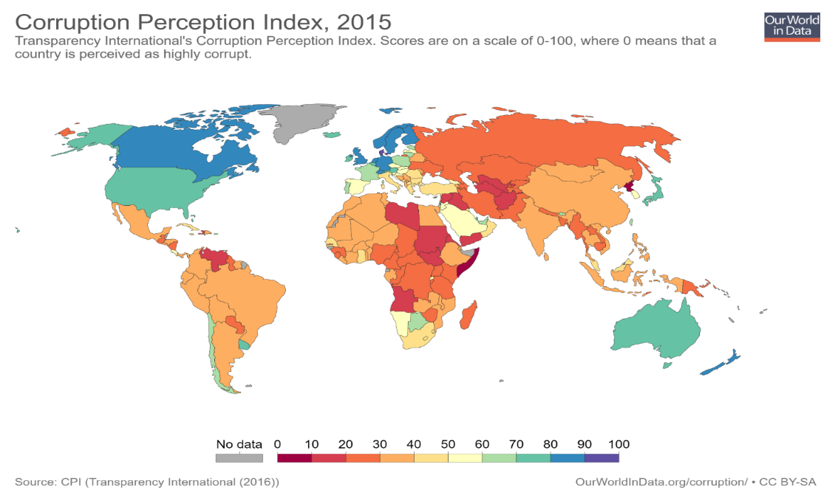
4. Politics and Regulation
Corruption
  49% of survey respondents believe corruption is common in a Western European construction market
22
Notes:
https://ourworldindata.org/corruption

Slide 23
4. Politics and Regulation
Geopolitical Uncertainty
  18 Turkish construction workers were kidnapped by militants in Baghdad in September 2015
23
Notes:
Complex Regulatory Requirements
25 different procedures are required for a typical warehouse construction permit in India
Slow Permit and Approval Process
$1.2 Trillion of infrastructure could be added by 2030 if all countries committed to specific time limits for approvals

Slide 24
Agenda
Construction Industry Environment
Trends Shaping the Industry
Industry Transformation Framework
Examples
24

Slide 25






































25

Slide 26
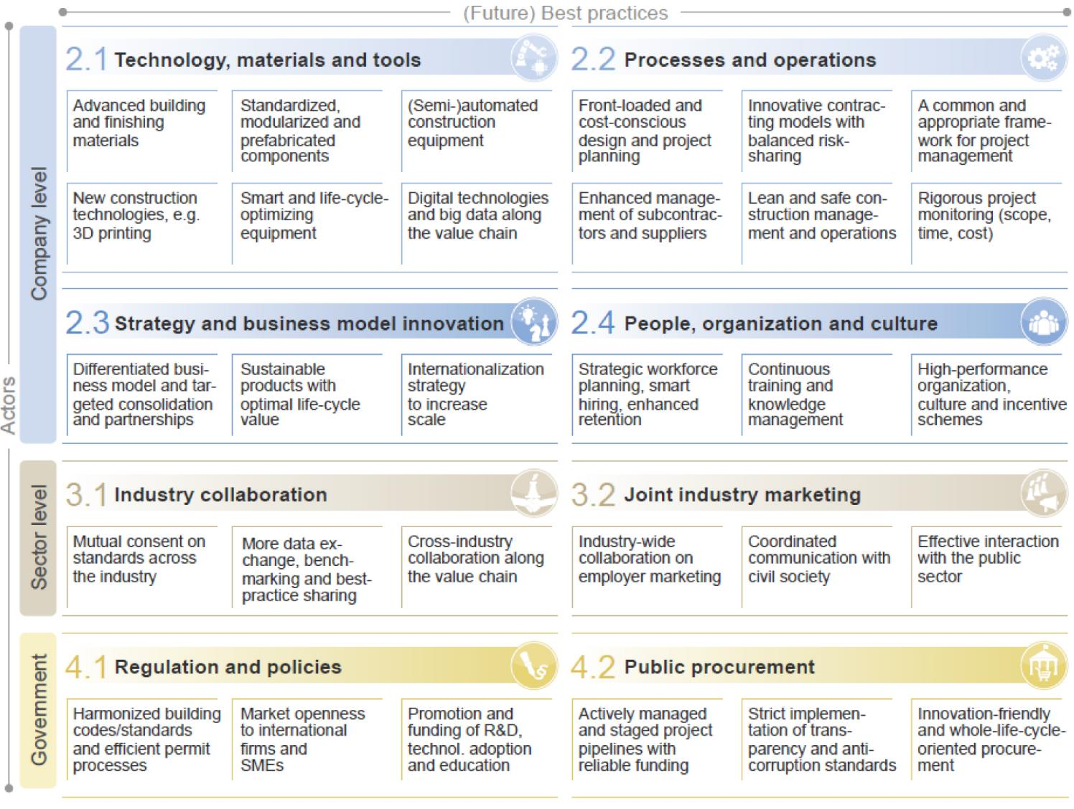
Notes:
Smart regulation is the key… regulatory framework should leave room for technological progress and should anticipate emerging needs… To achieve this… it is crucial to have well-designed building codes and standards, as well as transparent and streamlined permit processes…
Government procurement accounts for a major share of total construction expenditures worldwide… 31% in the UK, 44% in Germany, and around 57% in US…
As the industry’s most important client, governments need to actively manage and coordinate public-sector demand, and thereby drive industry change

Slide 27
Transformation areas in E&C Industry
Source: Future of Construction Survey; World Economic Forum; The Boston Consulting Group
27

Slide 28
Agenda
Construction Industry Environment
Trends Shaping the Industry
Industry Transformation Framework
Examples
28

Slide 29
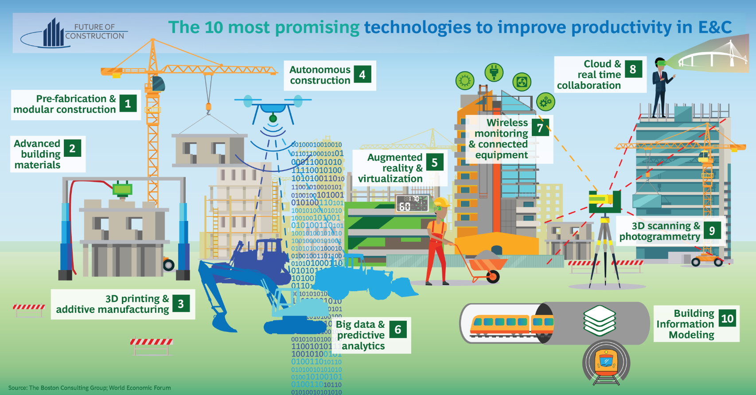
29
Notes:
BROAD Group China: Used a system of modular building components that enables very speedy construction… Builds 57-storey building in only 19 days by moving 90% of the construction work to the factory.
The level of innovative materials vary…
3d Printing
Japanese manufacturer of construction equipment, is developing automated bulldozers incorporating various digital systems… For example, Drones gather data, which is then transmitted to the bulldozers; which are equipped with intelligent machine-control systems that enable them to carry out their work autonomously and thereby speed up the pre-foundation work on construction sites, while human operators monitor the process… Actually… On mining sites, autonomous haul trucks are already in common use.

Slide 30
Learning faster and governing smarter
We are here!
Human Adaptability
Rate of Change
Technology
Time
Thomas Friedman’s “Thank You for Being Late” 2016
30

Slide 31
Coursera and MOOCs
Coursera provides universal access to the world’s best education, partnering with top universities and organizations to offer courses online.
MOOC: Massive Open Online Course. An online course aimed at unlimited participation and open access via the web.
31

Slide 32
Total Number of Learners since November 2016 reached 50,000, from 190 countries, with around 350 more every week!
32

Slide 33
In Conclusion…
The Construction Industry is at a Tipping point
There is a strong demand for improvement
  Aging infrastructure
  Urbanization
  Sustainability demands
  The affordability challenge
Traditionally slow to innovation, construction is starting to move … quickly
Some key enablers
  Owner awareness
  Supply chain capability
  Confrontation giving way to collaboration
  The digital age
  Greater engagement in the improvement agenda from all
We all have a role to play
Owners – Designers – Contractors – Subcontractors – Suppliers – Maintainers
– Academia – Disruptors – The Public
33

Slide 34
Thanks!
Ibrahim Odeh
ODEH@Columbia.Edu
34

Slide 35
Additional supporting slides; if needed!
35

Slide 36
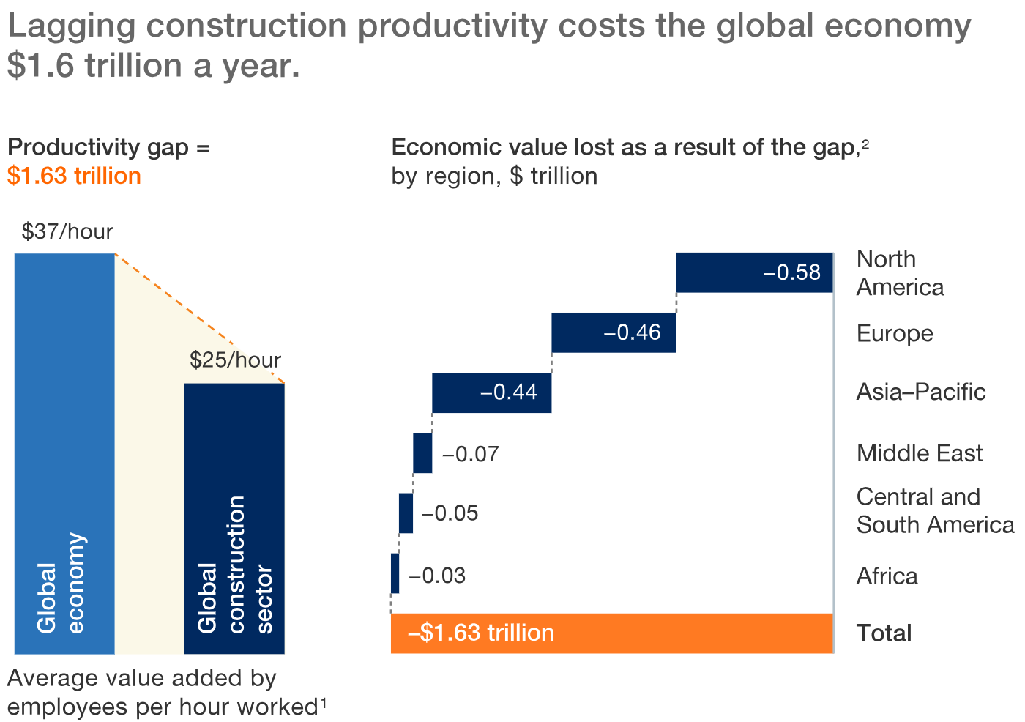

Index of US Labor Productivity
36

Slide 37
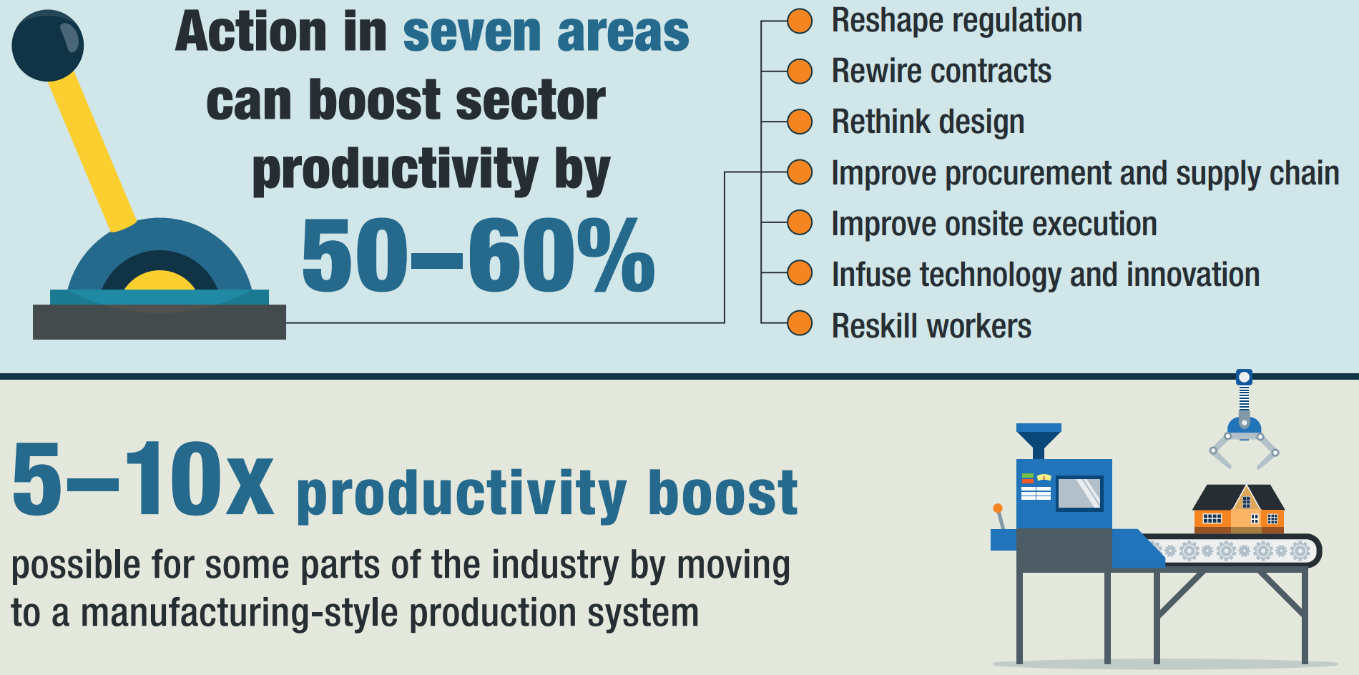
37

Slide 38
Improve Onsite Execution
Reshape Regulation
Rewire Contracts
Reskill Workers
Improve Procurement & Supply Chain
Rethink Design
Infuse Technology & Innovation
38

