Slide 1
Careers in Construction

Slide 2
Construction Industry in Context
170,000 + Employees
6% of Workforce
150,000 additional workers needed by 2030
Housing For All
33,000 new homes each year
2021 - 2030.
Construction Industry
Value of circa €30bn
12,000 retire annually
National Retrofitting Scheme
500,000 homes by 2030
National Development Plan: €165bn (2021-2030)

Slide 3
Total labour demand from housing construction will need to rise from approximately 40,000 fulltime equivalent workers at present, to 67,500 by 2025.
As the backlog of housing output has built up, a further increase, possibly up to 80,000 workers may be necessary.
It is suggested, that the following will need to be recruited or trained to meet demand.
Demand for Construction Workers
Labour Demand Estimates for Ireland’s National Housing Targets, 2021-2030 Report:
Carpenters & Joiners (+2,500)
Electricians (+1,900)
Elementary Construction Occupations (+1,800)
Plumbers (+1,300)
Painters & Decorators (+1,100)
Bricklayers & Masons (+700)
Production managers (+690)
Plasterers (+680)
Architects & Planners (+670)
Construction Operatives (+650)

Slide 4
Routes of Entry:
(i) CAO
(ii) Apprenticeship
(iii) Traineeship
(iv) General Operative
Varying Roles:
Design
Construct
Manage
Engineers - all disciplines
(e.g. Building Services, Electrical, Civil, Env.)
BIM / Digital Construction
Trades (all)
Vacancies / Opportunities
Cost Management / Quantity Surveyors
Construction Managers
Architects
Future Opportunities

Slide 5


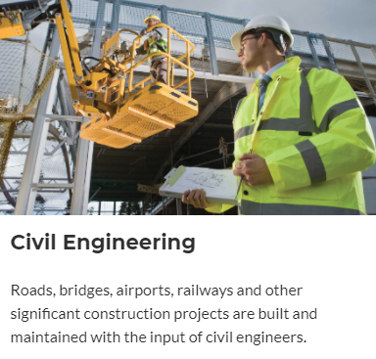

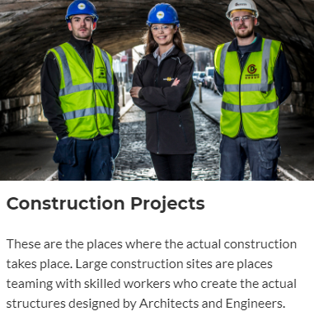


Slide 6
Reasons to work in the Construction Industry
1. You get to build important projects that communities rely on
Whether it’s a hospital, a road, a home, a sports stadium or a school, the things you build matter to the people in your community.
2. You get to see immediate results from your work
At the end of every day at work, you’ll be able to see the progress you and your team have made. Watching that progress turn into a completed project, day by day, is one of the most rewarding parts of a construction job.
3. Every day is something new
No two days are ever the same. Each day brings a new challenge and new possibilities. Each project you work on is different too. You have the ongoing opportunity to learn from other professionals, and the ability to learn new technologies as they emerge or evolve.

Slide 7
Reasons to work in the Construction Industry
4. You get to collaborate with a team
Strong networks are formed on construction projects because everyone on the team depends on everyone else to get the job done.
5. Earn while you learn
There are many ways into construction, whether you’ve just left school or are a changing career. You can earn while you learn as a construction apprentice or delve deeper into your chosen field with a degree.
6. You can build a lifelong career.
After finishing their apprenticeships many construction workers have set up their own businesses, and many are expanding into projects overseas with international construction jobs. With time and experience, construction workers can advance management positions – like foreman, superintendent, supervisor, project manager and construction manager or move into different areas such as health and safety.

Slide 8
Apprenticeships
Apprenticeships are “employer lead” – meaning that in order to get an apprenticeship, you must persuade an employer to register you as an apprentice. Once you have been registered, you will commence your seven phases as outlined in the next slide.
3 of these phases are through the training provider and 4 are on the job with an employer/construction company. The entire apprenticeship process takes approximately 4 years.
Apprentices get paid throughout all the phases. Rates increase as you progress.

Slide 9
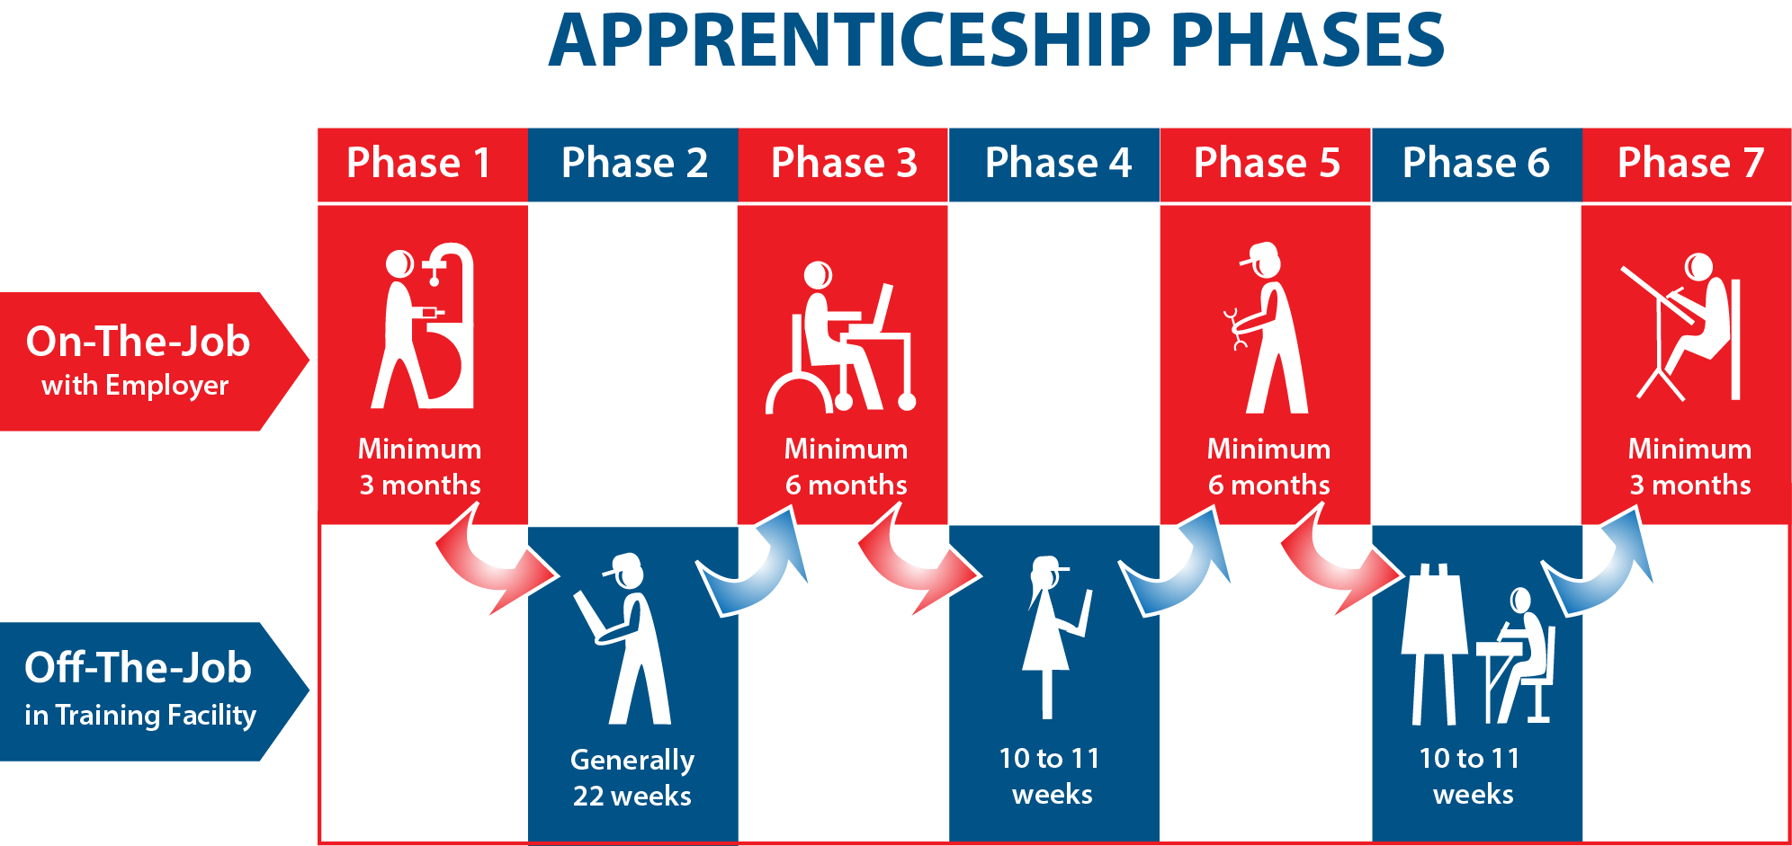
Apprenticeships

Slide 10
Types of Construction Apprenticeships
Brick & Stonelaying
Carpentry and Joinery
Electrical
Plumbing
Floor and Wall Tiling
Painting & Decorating
Plastering
Stonecutting & Stonemasonry
Civil Engineering
Wood Manufacturing and Finishing
Pipe Fitting
Electrical Instrumentation
Industrial Instrumentation
Industrial Insulation
Metal Fabrication
Sheet Metal Working
Construction Plant Fitting

Slide 11
Apprenticeship Pay
2025 2026
1st year rate (33.3%) €7.67 €7.91
2nd year rate (50%) €11.50 €11.87
3rd year rate (75%) €17.25 €17.81
4th year rate (90%) €20.70 €21.37
Craft worker* €23.00 €23.74
  - Based on 39 hour week
*stone layers, carpenters and joiners, floor layers, glaziers, painters, plasterers, stone cutters, wood machinists, slaters and tilers.

Slide 12
Construction Pay
There are separate wage agreements for the Electrical Sector and Mechanical Sector.
Construction employers must pay into a pension fund for employees.
Opportunities to earn time and a half and double time for working extra hours.
Can also be payments for lodging or travel, company car and mobile phone.

Slide 13
Apprentice Jobs
For more information on apprenticeships please visit:
Further information, videos on the different types of apprenticeships and current job opportunities:
www.apprenticeship.ie
https://careersportal.ie/apprenticeships
www.cif.ie/careersinconstruction

Slide 14
Construction Professionals
Construction Professionals work in three broad areas:
Civils
Civils deals with big infrastructure projects like roads and flood defences.
Building
Professionals involved in the building side of the industry are Involved in projects like shopping centres and industrial units.
Mechanical &Electrical
As the name suggests is a specialist area dealing with the fit-out of a building including heating, ventilation, air-conditioning and electrical works.

Slide 15
Third Level
There is a significant range of education and training opportunities for learners across Level 5(LC) to Level 9(Masters) on the National Framework of Qualifications in engineering, construction and craft Apprenticeship is Level 6.
CAO offer over 180 different construction related courses across the country.
These courses can be grouped as follows:
Architecture
Quantity Surveyor
Civil Engineering
Environmental Engineering
Electrical Engineering
Health & Safety
Mechanical Engineering
Building Information Modelling (BIM)
Construction Management
Energy Management/Sustainable Engineering

Slide 16
Construction Professional Starting Pay
Construction Economist/Quantity Surveyor: €34,000
Construction Manager: €41,000
Civil Engineer: €34,000
Structural Engineer: €32,000
Building Services Engineer: €35,000
Building Information Modeller (Coordinator): €48,000
Architect: €36,000
Health & Safety Officer: €32,000
Facilities Manager: €40,000
Site Manager: €40,000

Slide 17
Women in Construction
Women currently make up just 9% of the construction workforce, but this falls to 1% for on-site trades.
Attracting more women into the sector is a priority to grow a more diverse industry and to ensure that Ireland can meet its building targets.
More women in construction will lead to a more productive, diverse and efficient industry.
The industry is constantly evolving. With new developments in modern methods of construction (MMC) and digital construction so pivotal now to the industry, there is a diverse range of career options both on and off building sites.

Slide 18
Sectors & Industries
Construction professionals can work in many industries including:
Roads, Bridges and Tunnels, Rail Lines, Stations, Airports.
Water and Wastewater (such as Treatment Plants)
Public Buildings – Hospitals, Schools, Shopping Centres, Stadiums, Municipal Spaces, Hotels
Telecommunications Infrastructure
Data Centres

Slide 19
Sectors & Industries
Residential (Houses, Apartments)
Office Blocks
Factories
Power Infrastructure – Power Stations, Power Lines, Substations, Wind Farms
Oil and Gas – Offshore Rigs, Gas, Oil and LNG terminals,
Ports and docks
Mines

Slide 20
Questions

Slide 21
Get in Touch
www.cif.ie
cif@cif.ie

